Slide 1
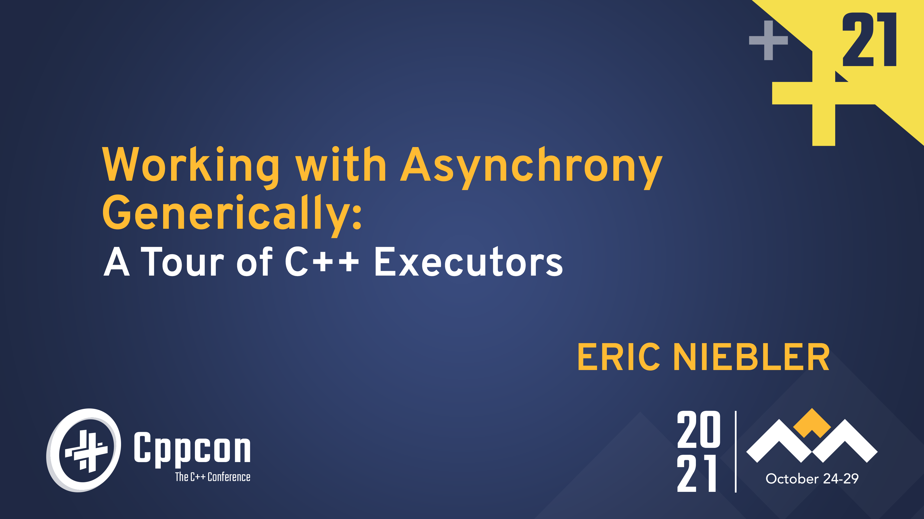

Slide 2
Talk outline
Part 1:
Goals for the Executors proposal
Some simple examples, intro to senders
The lifecycle of an async operation
Under the hood of a concurrent operation
Implementing a simple async algorithm
Senders and coroutines
Part 2:
Structured concurrency
Cancellation
An extended example

Slide 3
Goals for the executors proposal
The vision: “An asynchronous analog of the STL”
A full suite of standard async algorithms based on real-world requirements:
E.g., then, when_all, sync_wait, repeat, stop_when, timeout, etc. (not all proposed yet)
A standard set of abstractions (aka, concepts) derived from the algorithms
Efficient interoperability with coroutines
An open and extensible way to specify where, how, and when work should happen
… including some standard ones: an event loop, portable access to the system execution context, nursery for spawned work
Notes:
Not all of those algorithms are in the proposal, but they are part of the long-term vision

Slide 4
P2300: std::execution
Proposes:
A set of concepts that represent:
A handle to a compute resource (aka, scheduler)
A unit of lazy async work (aka, sender)
A completion handler (aka, receiver)
A small, initial set of generic async algorithms:
E.g., then, when_all, sync_wait, let_*
Utilities for integration with C++20 coroutines

Slide 5
Example 1:
Launching concurrent work

Slide 6
Example: Launching concurrent work
namespace ex = std::execution;
int compute_intensive(int);
int main() {
unifex::static_thread_pool pool{8};
ex::scheduler auto sched = pool.get_scheduler();
ex::sender auto work =
ex::when_all(
ex::then(ex::schedule(sched), [] { return compute_intensive(0); }),
ex::then(ex::schedule(sched), [] { return compute_intensive(1); }),
ex::then(ex::schedule(sched), [] { return compute_intensive(2); })
);
auto [a, b, c] = std::this_thread::sync_wait( std::move(work) ).value();
}
Launch three tasks to execute concurrently on a custom execution context
libunifex: https://github.com/facebookexperimental/libunifex

Slide 7
Example: Launching concurrent work
namespace ex = std::execution;
int compute_intensive(int);
int main() {
unifex::static_thread_pool pool{8};
ex::scheduler auto sched = pool.get_scheduler();
ex::sender auto work =
ex::when_all(
ex::then(ex::schedule(sched), [] { return compute_intensive(0); }),
ex::then(ex::schedule(sched), [] { return compute_intensive(1); }),
ex::then(ex::schedule(sched), [] { return compute_intensive(2); })
);
auto [a, b, c] = std::this_thread::sync_wait( std::move(work) ).value();
}
P2300 proposes these concepts and algorithms, among others.

Slide 8
Example: Launching concurrent work
namespace ex = std::execution;
int compute_intensive(int);
int main() {
unifex::static_thread_pool pool{8};
ex::scheduler auto sched = pool.get_scheduler();
ex::sender auto work =
ex::when_all(
ex::schedule(sched) | ex::then([] { return compute_intensive(0); }),
ex::schedule(sched) | ex::then([] { return compute_intensive(1); }),
ex::schedule(sched) | ex::then([] { return compute_intensive(2); })
);
auto [a, b, c] = std::this_thread::sync_wait( std::move(work) ).value();
}
Use pipe syntax if you want to.

Slide 9

Example: Launching concurrent work
namespace ex = std::execution;
int compute_intensive(int);
int main() {
unifex::static_thread_pool pool{8};
ex::scheduler auto sched = pool.get_scheduler();
ex::sender auto work =
ex::when_all(
ex::schedule(sched) | ex::then([] { return compute_intensive(0); }),
ex::schedule(sched) | ex::then([] { return compute_intensive(1); }),
ex::schedule(sched) | ex::then([] { return compute_intensive(2); })
);
auto [a, b, c] = std::this_thread::sync_wait( std::move(work) ).value();
}
Zero allocations here

Slide 10
Example: Launching concurrent work
ex::sender auto work =
ex::when_all(
ex::schedule(sched) | ex::then([] { return compute_intensive(0); }),
ex::schedule(sched) | ex::then([] { return compute_intensive(1); }),
ex::schedule(sched) | ex::then([] { return compute_intensive(2); })
);

Slide 11
Senders are expression templates
when_all
then
then
then
schedule
schedule
schedule
ex::sender auto work =
ex::when_all(
ex::schedule(sched) | ex::then([] { return compute_intensive(0); }),
ex::schedule(sched) | ex::then([] { return compute_intensive(1); }),
ex::schedule(sched) | ex::then([] { return compute_intensive(2); })
);
Notes:
A composition of senders builds a tree.

Slide 12
Senders are expression templates
when_all
then
then
then
schedule
schedule
schedule
ex::sender auto work =
ex::when_all(
ex::schedule(sched) | ex::then([] { return compute_intensive(0); }),
ex::schedule(sched) | ex::then([] { return compute_intensive(1); }),
ex::schedule(sched) | ex::then([] { return compute_intensive(2); })
);
Notes:
The expression tree is built with no allocations by aggregating child nodes into parents.

Slide 13
These expressions are all senders
when_all
when_all
then
then
then
then
then
then
schedule
schedule
schedule
schedule
schedule
schedule
ex::sender auto work =
ex::when_all(
ex::schedule(sched) | ex::then([] { return compute_intensive(0); }),
ex::schedule(sched) | ex::then([] { return compute_intensive(1); }),
ex::schedule(sched) | ex::then([] { return compute_intensive(2); })
);
ex::sender auto work =
ex::when_all(
ex::schedule(sched) | ex::then([] { return compute_intensive(0); }),
ex::schedule(sched) | ex::then([] { return compute_intensive(1); }),
ex::schedule(sched) | ex::then([] { return compute_intensive(2); })
);
ex::sender auto work =
ex::when_all(
ex::schedule(sched) | ex::then([] { return compute_intensive(0); }),
ex::schedule(sched) | ex::then([] { return compute_intensive(1); }),
ex::schedule(sched) | ex::then([] { return compute_intensive(2); })
);
ex::sender auto work =
ex::when_all(
ex::schedule(sched) | ex::then([] { return compute_intensive(0); }),
ex::schedule(sched) | ex::then([] { return compute_intensive(1); }),
ex::schedule(sched) | ex::then([] { return compute_intensive(2); })
);
ex::sender auto work =
ex::when_all(
ex::schedule(sched) | ex::then([] { return compute_intensive(0); }),
ex::schedule(sched) | ex::then([] { return compute_intensive(1); }),
ex::schedule(sched) | ex::then([] { return compute_intensive(2); })
);

Slide 14
Example 2:
Transitioning execution context

Slide 15
Example: transitioning execution context
namespace ex = std::execution;
ex::sender auto accept_request();
ex::sender auto process_request(request_t);
extern unifex::static_thread_pool low_latency;
extern unifex::static_thread_pool workers;
ex::sender auto accept_and_process_requests() {
return
ex::on(low_latency.get_scheduler(), accept_request())
| ex::transfer(workers.get_scheduler())
| ex::then([](auto request) { process_request(request); })
| unifex::repeat_effect();
}
Accept requests on low-latency threads. Process the requests on the worker threads.
Notes:
This only fetches the next request after the previous has finished processing. That’s probably not ideal, but could make sense if you launch many concurrent instances of accept_and_process_requests()

Slide 16
Example: transitioning execution context
namespace ex = std::execution;
ex::sender auto accept_request();
ex::sender auto process_request(request_t);
extern unifex::static_thread_pool low_latency;
extern unifex::static_thread_pool workers;
unifex::task<void> accept_and_process_requests() {
while (true) {
auto request =
co_await ex::on(low_latency.get_scheduler(), accept_request());
co_await ex::on(workers.get_scheduler(), process_request(request));
}
}
Or write it as a coroutine.
Notes:
What looks like an infinite loop is in fact not. Stay tuned.

Slide 17
Schedulers produce senders
Generic async algorithms accept and return senders

Slide 18
Sender adaptors of std::execution
Sender adaptors | Returns a sender that…
then(sender, fn) → sender | … transforms the result value of the operation with a function.
upon_[error|done](sender, fn) → sender | … transforms the error and done signals with a function.
let_[value|…](sender, fn) → sender | … passes the result of input sender to function, which returns new sender.
when_all(senders...) → sender | … completes when all the input senders complete.
on(scheduler, sender) → sender | … starts the input sender in the context of the input scheduler.
into_variant(sender) → sender | … packages all possible results of input sender into a variant of tuples.
bulk(sender, size, fn) → sender | … launches a bulk operation.
split(sender) → sender | … permits multiple receivers to be connected (forks the execution graph).
done_as_optional(sender) → sender | … commutes the done signal into a nullopt.
done_as_error(sender, error) → sender | … commutes the done signal into an error.
Notes:
These algorithms are combinators: they accept and return senders, so complex algorithms can be easily composed from smaller reusable components.

Slide 19
SENDER/RECEIVER CONTROL FLOW

Slide 20
Basic lifetime of an async operation
SCHEDULER
then(sender, fn) -> sender
schedule
SENDER
Implementation details of algorithms. Magic happens here.

Slide 21
Basic lifetime of an async operation
SCHEDULER
then(sender, fn) -> sender
schedule
connect
… and notifies receiver
SENDER
RECEIVER
start
OPERATION STATE
…operation
completes…
… time passes…
Implementation details of some algorithm; e.g., then.

Slide 22
Shape of a receiver
Operation state notifies receiver by calling one of these exactly once.
RECEIVER
set_value(values...)
set_error(error)
set_done()

Slide 23
Conceptual building blocks of P2300
concept scheduler:
schedule(scheduler) sender;
concept sender:
connect(sender, receiver) operation_state;
concept receiver:
set_value(receiver, Values...) void;
set_error(receiver, Error) void;
set_done(receiver) void;
concept operation_state:
start(operation_state) void;

Slide 24
Under the hood of a concurrent operation

Slide 25
All of these senders implement connect
when_all
connect
then
then
then
schedule
schedule
schedule
ex::sender auto work =
ex::when_all(
ex::schedule(sched) | ex::then([] { return compute_intensive(0); }),
ex::schedule(sched) | ex::then([] { return compute_intensive(1); }),
ex::schedule(sched) | ex::then([] { return compute_intensive(2); })
);
Notes:
The expression tree is built with no allocations by aggregating child nodes into parents.

Slide 26
All of these senders implement connect
when_all
connect
then
then
then
schedule
schedule
schedule
ex::sender auto work =
ex::when_all(
ex::schedule(sched) | ex::then([] { return compute_intensive(0); }),
ex::schedule(sched) | ex::then([] { return compute_intensive(1); }),
ex::schedule(sched) | ex::then([] { return compute_intensive(2); })
);
Notes:
The expression tree is built with no allocations by aggregating child nodes into parents.

Slide 27
Connect enriches receiver and recurses into children
receiver
when_all
X 3
connect
then
then
then
schedule
schedule
schedule
Notes:
In our example, where this sender was passed to `sync_wait`, the receiver is an implementation detail of `sync_wait`.

Slide 28
Connect enriches receiver and recurses into children
receiver
when_all
X 3
connect
then
then
then
connect
schedule
schedule
schedule

Slide 29
Connect returns an operation state
when_all
connect
receiver
then
then
then
X 3
schedule
schedule
schedule
connect
return
Operation state

Slide 30
Connect returns an operation state
when_all
connect
then
then
then
return
receiver
schedule
schedule
schedule
Operation state

Slide 31
Connect returns an operation state
when_all
connect
return
receiver
then
then
then
schedule
schedule
Operation state
schedule

Slide 32
Operations execute outside-in
Receiver
start
Operation state

Slide 33
Operations execute outside-in
Work is scheduled on the thread pool
Time passes….
Receiver
A thread in the pool picks up the work and executes it

Slide 34
Operations execute outside-in
Inner-most receiver is notified that the work is complete
Receiver
set_value
set_error
set_done
A thread in the pool picks up the work and executes it

Slide 35
Operations execute outside-in
Every adaptor has a chance to run code when the operation is starting and when the operation is finishing.
when_all
then
schedule
Notes:
These are layers of behavior, not necessarily of data. The resulting operation state may be quite small despite having many layers.

Slide 36

Senders nest
Receivers nest
Operation states nest

Slide 37
IMPLEMENTING AN ALGORITHM:
THEN

Slide 38
Algorithm example: then
namespace ex = std::execution;
template<ex::sender S, class F>
ex::sender auto then(S s, F f)
{
return _then_sender{{}, (S&&) s, (F&&) f};
}

Slide 39
Algorithm example: then
namespace ex = std::execution;
template<ex::sender S, class F>
ex::sender auto then(S s, F f)
{
return _then_sender{{}, (S&&) s, (F&&) f};
}
template<ex::sender S, class F>
struct _then_sender : ex::sender_base
{
S s_;
F f_;
// Implement connect(sender, receiver) -> operation_state: template<ex::receiver R>
requires ex::sender_to<S, _then_receiver<R, F>>
decltype(auto) connect(R r) &&
{
return ex::connect(
(S&&) s_, _then_receiver<R, F>{(R&&) r, (F&&) f_});
}
};

Slide 40
Algorithm example: then
template<ex::receiver R, class F>
struct _then_receiver
{
R r_;
F f_;
// Implement set_value(Values...) by invoking the callable and
// passing the result to the inner receiver:
template<class... As>
requires ex::receiver_of<R, std::invoke_result_t<F, As...>>
void set_value(As&&... as) &&
{
ex::set_value((R&&) r_, std::invoke((F&&) f_, (As&&) as...));
}
// Implement set_error(Values...) and set_done() as pass-throughs:
template<class Err>
requires ex::receiver<R, E>
void set_error(Err&& err) && noexcept
{
ex::set_error((R&&) r_, (Err&&) err);
}
void set_done() && noexcept
{
ex::set_done((R&&) r_);
}
};

Slide 41
Algorithm example: then
namespace ex = std::execution;
template<ex::sender S, class F>
ex::sender auto then(S s, F f)
{
return _then_sender{{}, (S&&) s, (F&&) f};
}
template<ex::receiver R, class F>
struct _then_receiver
{
R r_;
F f_;
// Implement set_value(Values...) by invoking the callable and
// passing the result to the inner receiver:
template<class... As>
requires ex::receiver_of<R, std::invoke_result_t<F, As...>>
void set_value(As&&... as) &&
{
ex::set_value((R&&) r_, std::invoke((F&&) f_, (As&&) as...));
}
// Implement set_error(Values...) and set_done() as pass-throughs:
template<class Err>
requires ex::receiver<R, E>
void set_error(Err&& err) && noexcept
{
ex::set_error((R&&) r_, (Err&&) err);
}
void set_done() && noexcept
{
ex::set_done((R&&) r_);
}
};
template<ex::sender S, class F>
struct _then_sender : ex::sender_base
{
S s_;
F f_;
// Implement connect(sender, receiver) -> operation_state: template<ex::receiver R>
requires ex::sender_to<S, _then_receiver<R, F>>
decltype(auto) connect(R r) &&
{
return ex::connect(
(S&&) s_,
_then_receiver<R, F>{(R&&) r, (F&&) f_});
}
};

Slide 42
SENDERS AND COROUTINES

Slide 43
Awaitables as senders
// This is a coroutine:
unifex::task<int> read_socket_async(socket, span<char, 1024>);
int main()
{
socket s = /*...*/;
char buff[1024];
auto [cbytes] = std::this_thread::sync_wait( read_socket_async(s, buff) ).value();
}
All awaitable types are senders and can be passed to any async algorithm that accepts a sender.
No extra allocation or synchronization is required.
Notes:
… apart from the necessary expense of starting a coroutine to await the awaitable

Slide 44
senders as AWAITABLES
// This is a coroutine:
unifex::task<int> read_socket_async(socket, span<char, 1024>);
unifex::task<void> concurrent_read_async(socket s1, socket s2)
{
char buff1[1024];
char buff2[1024];
auto [cbytes1, cbytes2] =
co_await std::execution::when_all(
read_socket_async(s1, buff1),
read_socket_async(s2, buff2)
) | into_tuple();
/*...*/
}
Most senders can be made awaitable in a coroutine type trivially.
No extra allocation or synchronization is necessary.

Slide 45
senders as AWAITABLES
// This is a coroutine task type:
template< class T >
struct task
{
struct promise_type :
std::execution::with_awaitable_senders<promise_type>
{
/*...*/
To make senders awaitable within a coroutine type, derive its promise type from with_awaitable_senders.

Slide 46
Coroutines and cancellation
If an awaited sender completes by calling set_done(), it behaves as though an uncatchable “exception” has been thrown. (The stack of awaiting coroutines is unwound.)
The cancellation “exception” is “caught” by applying a sender adaptor that translates the done signal into a value or an error before awaiting the sender; e.g., with:
std::execution::done_as_optional()
std::execution::done_as_error().
When the cancellation exception reaches an awaitable/sender boundary, it is automatically translated back into a call of set_done().
Notes:
It’s not an exception!
These are in P2300
This allows seamless propagation of cancellation notification, even when senders and coroutines have been freely intermixed

Slide 47
FLASHBACK: transitioning execution context
namespace ex = std::execution;
ex::sender auto accept_request();
ex::sender auto process_request(request_t);
extern unifex::static_thread_pool low_latency;
extern unifex::static_thread_pool workers;
unifex::task<void> accept_and_process_requests() {
while (true) {
auto request =
co_await ex::on(low_latency.get_scheduler(), accept_request());
co_await ex::on(workers.get_scheduler(), process_request(request));
}
}
unifex::task<void> accept_and_process_requests() {
while (true) {
auto request =
co_await ex::on(low_latency.get_scheduler(), accept_request());
co_await ex::on(workers.get_scheduler(), process_request(request));
}
}
If accept_request() completes by calling set_done(), the rest of the coroutine doesn’t execute.
Notes:
“ex::on” is “start on”

Slide 48
Example: Launching concurrent work
namespace ex = std::execution;
int compute_intensive(int);
int main() {
unifex::static_thread_pool pool{8};
ex::scheduler auto sched = pool.get_scheduler();
ex::sender auto work =
ex::when_all(
ex::schedule(sched) | ex::then([] { return compute_intensive(0); }),
ex::schedule(sched) | ex::then([] { return compute_intensive(1); }),
ex::schedule(sched) | ex::then([] { return compute_intensive(2); })
);
auto [a, b, c] = std::this_thread::sync_wait( std::move(work) ).value();
}
Notes:
Recall our example…

Slide 49
Example: Launching concurrent work
namespace ex = std::execution;
int compute_intensive(int);
int main() {
unifex::static_thread_pool pool{8};
ex::scheduler auto sched = pool.get_scheduler();
ex::sender auto work =
ex::when_all(
ex::schedule(sched) | ex::then([] { return compute_intensive(0); }),
ex::schedule(sched) | ex::then([] { return compute_intensive(1); }),
ex::schedule(sched) | ex::then([] { return compute_intensive(2); })
);
auto [a, b, c] = std::this_thread::sync_wait( std::move(work) ).value();
}
namespace ex = std::execution;
int compute_intensive(int);
int main() {
unifex::static_thread_pool pool{8};
ex::scheduler auto sched = pool.get_scheduler();
auto compute = [=](int i) -> unifex::task<int> {
co_await ex::schedule(sched) | unifex::complete_inline();
co_return compute_intensive(i);
};
ex::sender auto work = ex::when_all(compute(0), compute(1), compute(2));
auto [a, b, c] = std::this_thread::sync_wait( std::move(work) ).value();
}
Notes:
It can be rewritten using coroutines as shown.

Slide 50
Sender/Receiver and Coroutines
By returning a sender, an async function puts the choice of whether to use coroutines or not in the hands of the caller.

Slide 51
Coming up in the next hour:
Structured concurrency
Cancellation support in sender/receiver
Extended example: Sender/receiver and ranges

Slide 52
Additional resources
P2300R2: “std::execution”:
https://wg21.link/P2300R2
Libunifex:
https://github.com/facebookexperimental/libunifex

Slide 54
Summary from Part 1
Vision: “An asynchronous analogue of the STL”
Some simple examples, intro to senders
The lifecycle of an async operation with sender/receiver
Under the hood of a composite concurrent operation
Implementing a simple algorithm: then()
Senders and coroutines

Slide 55
what’s coming in part 2
Structured concurrency
Cancellation support in the sender/receiver abstraction
An extended example

Slide 56
Structured concurrency

Slide 57

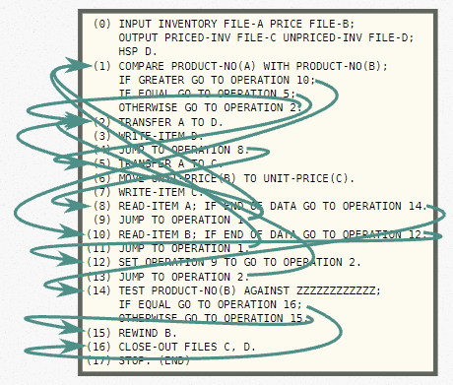
In the beginning … was goto
From: “Go Statement considered harmful,” by Nathaniel Smith

Slide 58

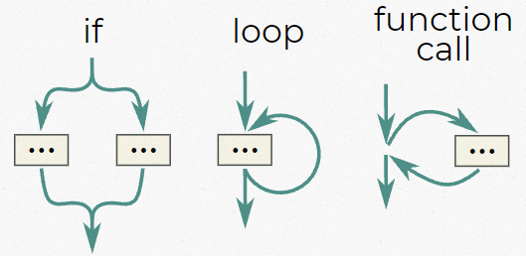

In the beginning … was goto Structured programming
Structured control flow constructs have a single entry and a single exit, permitting them to be treated like a black box.
goto is an unstructured control flow construct
goto
conditional
loop
function call
Notes:
Encapsulating control flow constructs into black-boxes is key to their composability.

Slide 59
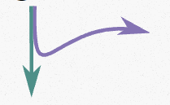
Fire-and-forget task models are UNstructured
Fire-and-forget work is like goto.
void compute_helper_async();
void compute_async(Executor ex)
{
/* ... */
// Spawn helper in specified context
// w/ an executor like in ASIO and NetTS
ex.execute(&compute_helper_async);
/* ... */
}
execute
Notes:
Any data accessed by both compute_async and its helper need to be one of: global, thread-local, or reference counted since the activations of these two operations do not nest

Slide 60
Coroutines are structured concurrency
// This is a coroutine:
task<int> compute_helper_async();
task<void> compute_async()
{
/* ... */
int i = co_await compute_helper_async();
/* ... */
}
coroutine
Awaiting a coroutine has a single entry and a single exit.
Notes:
Structure enforced by collaboration between the syntactic constructs and the coroutine task type.

Slide 61
Coroutines are structured concurrency
// This is a coroutine:
task<int> compute_helper_async();
task<void> compute_async()
{
/* ... */
int i = co_await compute_helper_async();
/* ... */
}
Activation of callee coroutine….
…is wholly nested within activation of the caller coroutine.
Notes:
“Activation of a coroutine” == a single execution of the coroutine

Slide 62
Coroutines are structured concurrency
// This is a coroutine:
task<int> compute_helper_async();
task<void> compute_async()
{
/* ... */
int i = co_await compute_helper_async();
/* ... */
}
Activations nest.
Scopes nest.
Lifetimes of locals nest.
RAII works.

Slide 63
Coroutines are structured concurrency
// This is a coroutine:
task<int> compute_helper_async();
task<void> compute_async()
{
/* ... */
int i = co_await compute_helper_async();
/* ... */
}
// This is a coroutine:
task<int> compute_helper_async(int& data);
task<void> compute_async()
{
int data = 0;
int i = co_await compute_helper_async(data);
/* ... */
}
Because of the nested scopes, it’s safe to pass locals by reference to callees...
… no dynamic allocation or reference counting needed.
Notes:
This only works if you immediately co_await the returned task. If compute_async were to return the task returned by compute_helper_async(), the reference would dangle.

Slide 64
Sender/receiver is also structured concurrency
when_all
Senders
then
then
then
Receivers
schedule
schedule
schedule
Operation states
Activations nest.
Scopes nest.
Lifetimes of locals nest.
RAII works.
Notes:
It is the algorithms that are enforcing the structure by enforcing that all concurrent operations are joined on all code paths.
The structure of the computation is why it’s possible to schedule and execute work with no allocations. (E.g., sync_wait places the operation state on the stack.)

Slide 65


No detached computation allowed
schedule
set_value
then
detached computation
schedule
set_error
then
schedule
set_value
then
A thread in the thread pool picks up this work and executes it.
when_all
set_error
time
Notes:
when_all semantics: if any of the child operations complete with an error, the when_all completes with an error

Slide 66
No detached computation allowed
schedule
set_value
then
detached computation
schedule
set_error
then
schedule
set_value
then
when_all
A thread in the thread pool picks up this work and executes it.
set_error
time
Notes:
when_all semantics: if any of the child operations complete with an error, the when_all completes with an error

Slide 67
Why is detached computation bad?
int compute_helper(int& data);
void compute()
{
int data = 0;
int result = compute_helper(data);
/* ... */
}
What would happen if compute() could return after calling compute_helper() but before compute_helper() returned?

Slide 68

Concurrency must be joined!
schedule
set_value
then
schedule
set_error
then
schedule
set_value
then
when_all
set_error
time

Slide 69

Concurrency must be joined!
schedule
set_done
then
schedule
set_error
then
Request stop
schedule
set_done
then
when_all
set_error
time
Notes:
need for cancellation goes hand-in-hand with concurrency
if you have two things that are running concurrently often completion of one with certain results will mean that you no longer need the other result

Slide 70
Concurrency must be joined!
schedule
set_done
then
schedule
set_error
then
Request stop
schedule
set_done
then
when_all
set_error
time
Notes:
need for cancellation goes hand-in-hand with concurrency
if you have two things that are running concurrently often completion of one with certain results will mean that you no longer need the other result

Slide 71
In structured concurrency, deep support for cooperative cancellation is essential for good performance.

Slide 72
CANCELLATION IN SENDER/RECEIVER

Slide 73
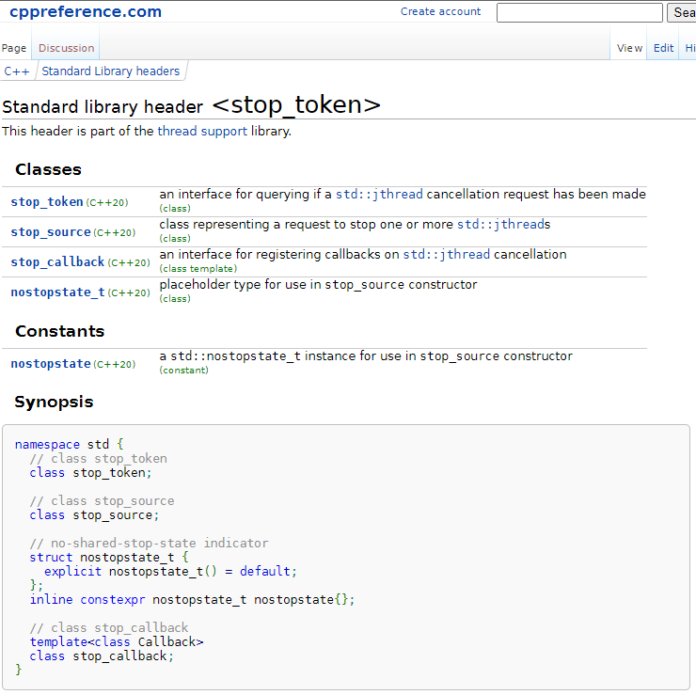
Cancellation support in C++20
Built on top of C++20’s std::stop_token support
Calling code…
… declares a std::stop_source and calls get_token() on it to get a stop token,
… passes the token to an async operation when launching it, and
… calls request_stop() on the stop source when it wants the async operation to stop early.
Async code can either…
… poll the token periodically to see if stop has been requested, or…
… register a callback to be executed when the caller requests stop.
https://en.cppreference.com/w/cpp/header/stop_token

Slide 74

Cancellation in sender/receiver
Some senders have stop sources.
They pass stop tokens to the operation state.
Cancellation details are internal to algorithms.
… and calls set_done() on the receiver
SENDER
connect
RECEIVER
stop source
start
“Hey, operation! I don’t need your result anymore. Mind stopping early, please?”
OPERATION STATE
…operation
completes early…
stop token
… time passes…
“I’ll do my best!”
“Hey, receiver! I’ve stopped!”

Slide 75

Cancellation is a three-way handshake
“I’ve stopped.”
“Please stop.”
Caller
OpState
Receiver
Notes:
Caller == initiator of the async operation

Slide 76
Senders pass stop tokens to children via receivers
stop_token
receiver
receiver
when_all
X 3
stop_source
connect
then
then
then
schedule
schedule
schedule
Notes:
When_all defines a cancellation scope; it has a stop_source and it associates a stop_token with the receivers it passes to then’s connect(). Nested operations can request that stop token from the receiver and either poll it for a stop request or register a stop callback to interrupt the operation.
In general, ambient state of the running task graph is propagated from parents to children via the receivers, as shown here with the stop token. (E.g., current scheduler, allocator, etc.)
the problem with passing a stop-token as an argument to a sender algorithm is that it means that higher-order algorithms (like when_all) can't inject their own stop-tokens

Slide 77
Sender/receiver and cancellation
Orchestrating cancellation is the job of the algorithms, not the user.
Only algorithms that introduce concurrency need to handle cancellation.
Cancellation is asynchronous and cooperative.
Cancellation is best-effort
No guarantee an operation will stop promptly or at all
Dedicated algorithms capture common cancellation patterns
e.g.: unifex::stop_when()
Notes:
But many leaf nodes will need to be responsive to requests to cancel.

Slide 78
Example: unifex::stop_when
// unifex::stop_when(
// sender auto task,
// sender auto condition) -> sender auto;
//
// stop_when takes two senders:
// 1. task: the async operation to perform
// 2. condition: the async stopping condition
//
// When one operation finishes, it cancels the other. It completes
// with the result of `task` when both operations complete.
// process input in a loop until the user interrupts:
ex::sender auto work_loop =
unifex::stop_when(
unifex::repeat_effect( processInput() ),
userInterrupt()
);
Notes:
stop_when has an associated stop_source
It associates a stop_token with the receiver it passes to repeat_effect( processInput() )

Slide 79
AN EXTENDED EXAMPLE:
SENDERS, COROUTINES, AND RANGES, OH MY!

Slide 80
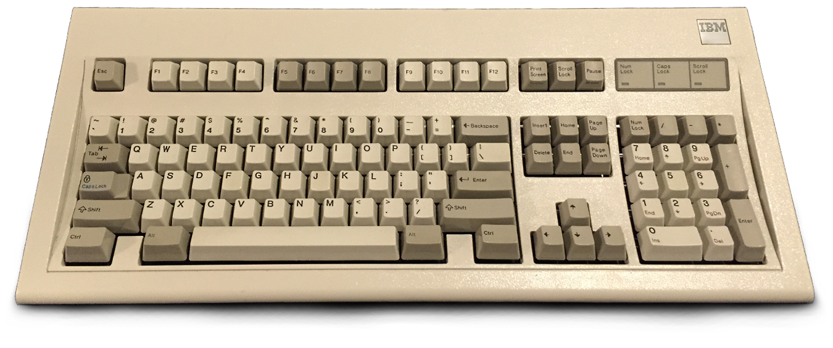

But first, a sad ☹ story about a boy and the greatest keyboard ever made….

Slide 81
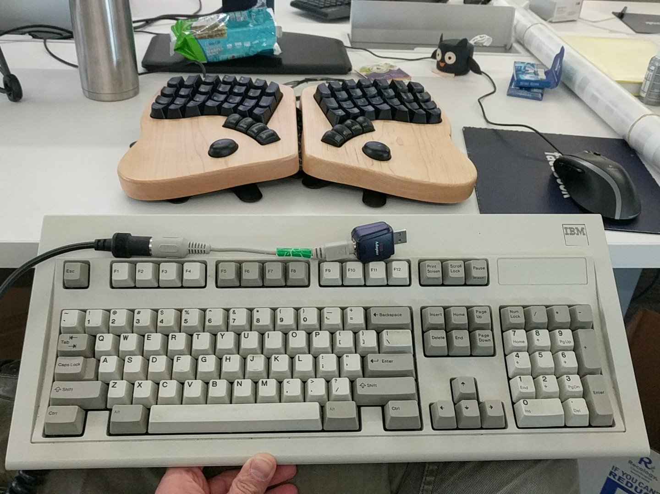

Slide 82
The mission:
Write a program that monitors the entire system for keyboard events and plays Model M clicky sounds.
Notes:
Wife: Great! Then you can listen to your keyboard on your headphones and the rest of us don’t have to hear it!

Slide 83
Model m simulator: strategy
Model a key click as a sender
Model keyboard input as a range of senders
Model interrupt (e.g., Ctrl-C) as a sender
Asynchronously transform range of senders into clicky noises until interrupt sender completes.
???
Profit!

Slide 84
Step 1:
Model key click as a sender

Slide 85
Model keyclick as sender: strategy
Assume system API for registering keyboard callback
Write a keyboard sender and op state such that:
...the sender’s connect() returns the op state wrapping the user’s receiver.
...the op state’s start() places a callback that completes the receiver in a global.
Register a keyboard callback that reads the completion info out of the global and completes it if it’s not null.
Notes:
Yes, global (or shared static) state sucks. Many times, low-level system APIs force our hand, as is the case with the Win32 API as we’ll see. When designing your APIs you can do better by registering a pointer to some context along with your callback.

Slide 86
Keyclick sender
// Type-erased receiver waiting for a keyclick:
struct pending_completion {
virtual void complete(char) = 0;
virtual ~pending_completion() {}
};
// Global registration of next completion:
std::atomic<pending_completion*> pending_completion_{nullptr};
// Keyboard input callback to register with the system:
static void on_keyclick(char ch) {
auto* current = pending_completion_.exchange(nullptr);
if (current != nullptr) {
current->complete(ch);
}
}
Notes:
If we wanted to permit multiple completions to be registered at once, we would have an intrusive linked list of pending completions, and the global would be a pointer to the head of the list.

Slide 87
Keyclick sender
// Sender that completes with the next keyclick
// read from stdin:
struct keyclick_sender : _sender_of<char>
{
auto connect(unifex::receiver_of<char> auto rec) {
return keyclick_operation{std::move(rec)};
}
};
keyclick_sender read_keyclick() {
return {};
}
Notes:
_sender_of is an implementation detail of this example, details not important, the shape of it is likely to change in the future.

Slide 88
Keyclick sender
// Operation state for a single key click:
template <unifex::receiver_of<char> Rec>
struct keyclick_operation : pending_completion {
Rec rec_;
explicit keyclick_operation(Rec rec) : rec_(std::move(rec)) {}
void complete(char ch) override final {
if (ch == CTRL_C)
unifex::set_done(std::move(rec_));
else
unifex::set_value(std::move(rec_), ch);
}
void start() noexcept {
// Enqueue the operation
auto* previous = pending_completion_.exchange(this);
assert(previous == nullptr);
}
};
Notes:
Special handling for Ctrl-C will be replaced with something more general later.

Slide 89
Keyclick sender
// Operation state for a single key click:
template <unifex::receiver_of<char> Rec>
struct keyclick_operation : pending_completion {
Rec rec_;
explicit keyclick_operation(Rec rec) : rec_(std::move(rec)) {}
void complete(char ch) override final {
if (ch == CTRL_C)
unifex::set_done(std::move(rec_));
else
unifex::set_value(std::move(rec_), ch);
}
void start() noexcept {
// Enqueue the operation
auto* previous = pending_completion_.exchange(this);
assert(previous == nullptr);
}
};

Slide 90
…Or use a helper to create the sender
auto read_keyclick() {
return unifex::create_simple<char>(
[](unifex::receiver_of<char> auto& r) {
return keyclick_state{r};
});
}
// State for a single key click:
template <unifex::receiver_of<char> Rec>
struct keyclick_state : pending_completion {
Rec& rec_;
explicit keyclick_state(Rec& rec) : rec_(rec) {
// Enqueue the operation
auto* previous =
pending_completion_.exchange(this);
assert(previous == nullptr);
}
void complete(char ch) override final {
if (ch == CTRL_C)
unifex::set_done(std::move(rec_));
else
unifex::set_value(std::move(rec_), ch);
}
keyclick_state(keyclick_state &&) = delete;
};
Returns a sender whose operation state:
calls the lambda in its start() function
stores the returned object in the operation state
Notes:
The create utility in unifex’s main branch can’t do this yet. PR forthcoming.

Slide 91
“system” API for registering keyboard callback
// Fake system API for registering keyboard input callback:
void register_keyboard_callback(void (*callback)(char)) {
static std::jthread th([=](std::stop_token token) {
while (!token.stop_requested()) {
int ch = _getch(); // Totally not portable! ☹
callback((char)ch);
if (ch == CTRL_C)
break;
}
});
}
Notes:
HACK HACK HACK

Slide 92
Putting the pieces together
int main() {
register_keyboard_callback(on_keyclick);
// Build an operation that reads a keyclick and
// executes a continuation:
auto read_next_char =
read_keyclick()
| unifex::then([](char ch) {
printf("In then with char: %c\n", ch);
});
(void) unifex::sync_wait(read_next_char);
}
(demo 1)

Slide 93
Putting the pieces together
int main() {
register_keyboard_callback(on_keyclick);
// Build an operation that reads a keyclick and
// executes a continuation:
auto read_next_char =
read_keyclick()
| unifex::then([](char ch) {
printf("Got a character! %c\n", ch);
});
(void) unifex::sync_wait(read_next_char);
}
The mission:
Write a program that monitors the entire system for keyboard events and plays Model M clicky sounds.

Slide 94
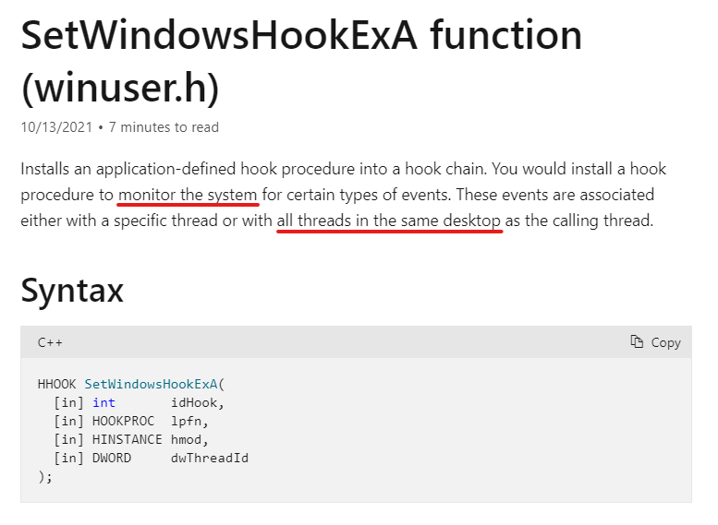

Hacking hooking windows

Slide 95
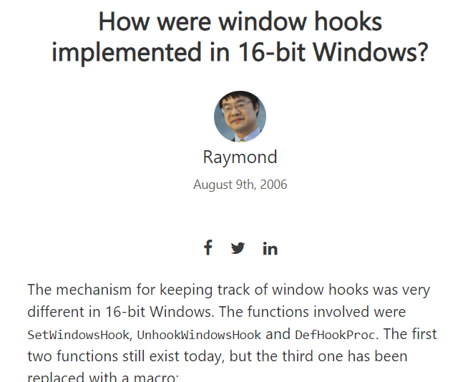
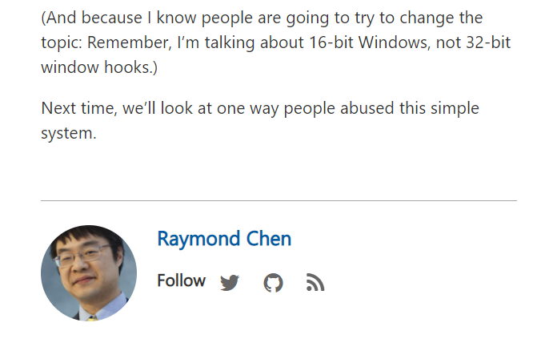

Hacking hooking windows
Raymond Chen, “Old New Thing”, https://devblogs.microsoft.com/oldnewthing/20060809-18/?p=30183

Slide 96
Step 2:
Model keyboard input as a range of senders

Slide 97
A Range of keyclick senders
auto keyclicks() {
// Return an infinite range of async
// keyclicks
return std::views::iota(0u)
| std::views::transform([](auto) {
return read_keyclick();
});
}
unifex::task<void> echo_keyclicks() {
for (auto keyclick : keyclicks()) {
char ch = co_await std::move(keyclick);
printf("Read a character! %c\n", ch);
}
}
int main() {
register_keyboard_callback(on_keyclick);
(void)unifex::sync_wait(echo_keyclicks());
}

Slide 98
A Range of keyclick senders
unifex::task<void> echo_keyclicks() {
for (auto keyclick : keyclicks()) {
char ch = co_await std::move(keyclick);
printf("Read a character! %c\n", ch);
}
}
int main() {
register_keyboard_callback(on_keyclick);
(void)unifex::sync_wait(echo_keyclicks());
}
If the keyclick is Ctrl-C, the sender completes by calling set_done().
In a coroutine, if an awaited sender completes with set_done(), the result is an uncatchable “exception”.
sync_wait() handles this “exception” and returns an empty optional.
Notes:
Letting a cancellation “exception” propagate out of echo_keyclicks() is likely to surprise callers

Slide 99
A Range of keyclick senders
unifex::task<void> echo_keyclicks() {
for (auto keyclick : keyclicks()) {
std::optional<char> ch =
co_await unifex::done_as_optional(std::move(keyclick));
if (ch) {
printf("Read a character! %c\n", *ch);
} else {
printf("Interrupt!\n");
break;
}
}
}
Use done_as_optional() to “catch” the cancellation and map it into an empty optional.
(demo 2)

Slide 100
A Range of keyclick senders
unifex::task<void> echo_keyclicks() {
for (auto keyclick : keyclicks() | std::views::transform(unifex::done_as_optional)) {
std::optional<char> ch = co_await std::move(keyclick);
if (ch) {
printf("Read a character! %c\n", ch);
} else {
printf("Interrupt!\n");
break;
}
}
}
Sender transformation could also be applied with a range transform.
Notes:
Observation: It’s not hard to imagine that just as we may want to apply range adaptors to the senders themselves (as shown here), we might also want range adaptors that apply to the results of the senders. Asynchronous ranges beg asynchronous range adaptors.

Slide 101
A Range of keyclick senders
keyclicks() | std::views::transform(unifex::done_as_optional)
This is a synchronous range adaptor, which applies to the senders themselves.
It’s not hard to imagine one might want to apply a range adaptor to the results of the senders.
Asynchronous ranges beg asynchronous range adaptors.
Notes:
aka, Reactive Extensions

Slide 102
Step 3:
Model Ctrl-C as a sender

Slide 103
Ctrl-C sender (windows-specific)
consoleHandler() checks if there is a pending completion. If so, it completes it.
struct ctrl_c_handler {
struct pending {
virtual void complete() = 0;
virtual ~pending() {}
};
static inline std::atomic<pending*> pending_{nullptr};
static BOOL WINAPI consoleHandler(DWORD signal) {
if (signal == CTRL_C_EVENT) {
if (auto* pending = pending_.exchange(nullptr))
pending->complete();
}
return TRUE;
}
ctrl_c_handler() {
BOOL result = ::SetConsoleCtrlHandler(&consoleHandler,TRUE);
assert(result);
}
~ctrl_c_handler() {
BOOL result = ::SetConsoleCtrlHandler(&consoleHandler,FALSE);
assert(result);
}
ctrl_c_handler(ctrl_c_handler&&) = delete;
[[nodiscard]] auto event() const;
};
auto ctrl_c_handler::event() const {
return unifex::create_simple<>(
[]<unifex::receiver_of R>(R& rec) {
struct state : pending {
R& rec_;
state(R& rec) : rec_(rec) {
auto* previous = pending_.exchange(this);
assert(previous == nullptr);
}
void complete() override final { unifex::set_value(std::move(rec_)); }
state(state&&) = delete;
};
return state{rec};
}
);
}
The constructor registers the control handler, and the destructor unregisters it.

Slide 104
Ctrl-C sender (windows-specific)
[[nodiscard]] auto event() const;
};
auto ctrl_c_handler::event() const {
return unifex::create_simple<>(
[]<unifex::receiver_of R>(R& rec) {
struct state : pending {
R& rec_;
state(R& rec) : rec_(rec) {
auto* previous = pending_.exchange(this);
assert(previous == nullptr);
}
void complete() override final { unifex::set_value(std::move(rec_)); }
state(state&&) = delete;
};
return state{rec};
}
);
}
return unifex::create_simple<>(
);
}
ctrl_c_handler::event() returns a sender…

Slide 105
Ctrl-C sender (windows-specific)
[[nodiscard]] auto event() const;
};
auto ctrl_c_handler::event() const {
return unifex::create_simple<>(
[]<unifex::receiver_of R>(R& rec) {
struct state : pending {
R& rec_;
state(R& rec) : rec_(rec) {
auto* previous = pending_.exchange(this);
assert(previous == nullptr);
}
void complete() override final { unifex::set_value(std::move(rec_)); }
state(state&&) = delete;
};
return state{rec};
}
);
}
[]<unifex::receiver_of R>(R& rec) {
}
ctrl_c_handler::event() returns a sender…
whose operation state calls this lambda in its start() function …

Slide 106
Ctrl-C sender (windows-specific)
[[nodiscard]] auto event() const;
};
auto ctrl_c_handler::event() const {
return unifex::create_simple<>(
[]<unifex::receiver_of R>(R& rec) {
struct state : pending {
R& rec_;
state(R& rec) : rec_(rec) {
auto* previous = pending_.exchange(this);
assert(previous == nullptr);
}
void complete() override final { unifex::set_value(std::move(rec_)); }
state(state&&) = delete;
};
return state{rec};
}
);
}
struct state : pending {
R& rec_;
state(R& rec) : rec_(rec) {
auto* previous = pending_.exchange(this);
assert(previous == nullptr);
}
void complete() override final { unifex::set_value(std::move(rec_)); }
state(state&&) = delete;
};
return state{rec};
ctrl_c_handler::event() returns a sender…
whose operation state calls this lambda in its start() function …
that returns this object to be stored in the operation state.

Slide 107
Ctrl-C sender (windows-specific)
[[nodiscard]] auto event() const;
};
auto ctrl_c_handler::event() const {
return unifex::create_simple<>(
[]<unifex::receiver_of R>(R& rec) {
struct state : pending {
R& rec_;
state(R& rec) : rec_(rec) {
auto* previous = pending_.exchange(this);
assert(previous == nullptr);
}
void complete() override final { unifex::set_value(std::move(rec_)); }
state(state&&) = delete;
};
return state{rec};
}
);
}
int main() {
ctrl_c_handler ctrl_c;
(void) unifex::sync_wait(
ctrl_c.event()
| unifex::then([]{ printf("Got Ctrl-C\n"); })
);
}

Slide 108
Step 4:
Asynchronously transform range of senders into clicky noises until interrupt sender completes.
Step 4:
Asynchronously transform range of senders into clicky noises until interrupt sender completes.

Slide 109
… until interrupt sender completes
Use unifex::stop_when() sender adaptor to send stop request when Ctrl-C sender completes.
Remove no-longer-necessary special handling for Ctrl-C from the keyclick_operation.

Slide 110
… until interrupt sender completes
int main() {
register_keyboard_callback(on_keyclick);
(void) unifex::sync_wait(echo_keyclicks());
}
int main() {
register_keyboard_callback(on_keyclick);
ctrl_c_handler ctrl_c;
(void) unifex::sync_wait(
echo_keyclicks()
| unifex::stop_when(ctrl_c.event()));
}
stop_when() sends a stop request to its
child operation (echo_keyclicks)
when its trigger (ctrl_c.event)
completes…
Notes:
Stop_when defines a new cancellation scope (stop_source) for its child operation and all its children.

Slide 111
… until interrupt sender completes
template <unifex::receiver_of<char> Rec>
struct keyclick_operation : pending_completion {
Rec rec_;
explicit keyclick_operation(Rec rec)
: rec_(std::move(rec)) {}
void complete(char ch) override final {
if (CTRL_C == ch)
unifex::set_done(std::move(rec_));
else
unifex::set_value(std::move(rec_), ch);
}
void start() noexcept {
// Enqueue the operation
auto* previous = pending_completion_.exchange(this);
assert(previous == nullptr);
}
};
Since we are externalizing the stop condition, we can remove the special handling for Ctrl-C from keyclick_operation.

Slide 112
… until interrupt sender completes
template <unifex::receiver_of<char> Rec>
struct keyclick_operation : pending_completion {
Rec rec_;
explicit keyclick_operation(Rec rec)
: rec_(std::move(rec)) {}
void complete(char ch) override final {
unifex::set_value(std::move(rec_), ch);
}
void start() noexcept {
// Enqueue the operation
auto* previous = pending_completion_.exchange(this);
assert(previous == nullptr);
}
};
Since we are externalizing the stop condition, we can remove the special handling for Ctrl-C from keyclick_operation.
(demo 3)

Slide 113
Q: Why doesn’t this work?
A: Although stop_when() sends a stop request, the keyclick operation isn’t listening for one!
It should register a stop callback.

Slide 114
Make keyclick operations interruptable
struct pending_completion {
virtual void complete(char) = 0;
virtual ~pending_completion() {}
};
struct pending_completion {
virtual void complete(char) = 0;
virtual void cancel() = 0;
virtual ~pending_completion() {}
};
// Function to execute (synchronously) when the
// stop_when() algorithm requests stop of its stop
// source.
struct cancel_keyclick {
void operator()() const noexcept {
auto* current = pending_completion_.exchange(nullptr);
if (current != nullptr) {
current->cancel();
}
}
};
Add a way to cancel a pending completion.
Write a function that cancels the pending completion.

Slide 115
… until interrupt sender completes
template <unifex::receiver_of<char> Rec>
struct keyclick_operation : pending_completion {
Rec rec_;
std::optional<stop_callback_for_t<Rec, cancel_keyclick>> on_stop_{};
explicit keyclick_operation(Rec rec) : rec_(std::move(rec)) {}
void complete(char ch) override final {
unifex::set_value(std::move(rec_), ch);
}
void cancel() override final {
unifex::set_done(std::move(rec_));
}
void start() noexcept {
on_stop_.emplace(unifex::get_stop_token(rec_), cancel_keyclick{});
auto* previous = pending_completion_.exchange(this);
assert(previous == nullptr);
}
};
template <unifex::receiver_of<char> Rec>
struct keyclick_operation : pending_completion {
Rec rec_;
explicit keyclick_operation(Rec rec)
: rec_(std::move(rec)) {}
void complete(char ch) override final {
unifex::set_value(std::move(rec_), ch);
}
void start() noexcept {
// Enqueue the operation
auto* previous = pending_completion_.exchange(this);
assert(previous == nullptr);
}
};
Register a stop callback with the receiver’s associated stop token that will cancel the outstanding completion.
This stop token receives stop requests from the stop source in the stop_when() algorithm.

Slide 116
… until interrupt sender completes
template <unifex::receiver_of<char> Rec>
struct keyclick_operation : pending_completion {
Rec rec_;
std::optional<stop_callback_for_t<Rec, cancel_keyclick>> on_stop_{};
explicit keyclick_operation(Rec rec) : rec_(std::move(rec)) {}
void complete(char ch) override final {
unifex::set_value(std::move(rec_), ch);
}
void cancel() override final {
unifex::set_done(std::move(rec_));
}
void start() noexcept {
on_stop_.emplace(unifex::get_stop_token(rec_), cancel_keyclick{});
auto* previous = pending_completion_.exchange(this);
assert(previous == nullptr);
}
};
template <unifex::receiver_of<char> Rec>
struct keyclick_operation : pending_completion {
Rec rec_;
explicit keyclick_operation(Rec rec)
: rec_(std::move(rec)) {}
void complete(char ch) override final {
unifex::set_value(std::move(rec_), ch);
}
void start() noexcept {
// Enqueue the operation
auto* previous = pending_completion_.exchange(this);
assert(previous == nullptr);
}
};
Here be dragons.
Notes:
This code isn’t quite right due to the racy nature of cancellation. Better would be to serialize all accesses to the pending_completion_ global and the construction of the stop callback by doing it all from a dedicated thread.
Then, if the stop callback fires and there is no pending completion, record that fact in a bool so that the next time we have a completion pending, we can cancel it straight away.

Slide 117
… and now this works
int main() {
register_keyboard_callback(on_keyclick);
(void) unifex::sync_wait(echo_keyclicks());
}
int main() {
register_keyboard_callback(on_keyclick);
ctrl_c_handler ctrl_c;
(void) unifex::sync_wait(
echo_keyclicks()
| unifex::stop_when(ctrl_c.event()));
}
stop_when() sends a stop request to its child operation (echo_keyclicks()) when its trigger (ctrl_c.event()) completes…
(demo 4)
Notes:
Demo 4, if there’s time

Slide 118
All that remains is a boat-load of nasty platform-specific hackery
(hook Windows events, play clicky sounds).
You can find all the demo code including the full-fat example from Kirk Shoop at: https://github.com/ericniebler/executors_demo_code_cppcon_2021.git
Notes:
But can be found online in Kirk Shoop’s fork of the libunifex repo.

Slide 119
DEMO TIME
(with huge shoutout to Kirk Shoop)
Notes:
But can be found online in Kirk Shoop’s fork of the libunifex repo.

Slide 120
Where to now?

Slide 121
What’s to come
P2300 “std::execution”, currently on track for C++23, brings:
the concepts,
the customization points,
a handful of fundamental async algorithms,
coroutine integration, and
integration with the C++17 parallel algorithms.
Future additions will include:
more standard async algorithms (see libunifex)
a timed_scheduler concept and time-based async algorithms; e.g., timeout().
portable access to a “system” scheduler, backed by e.g., Windows Thread Pool or GCD
a manual event loop scheduler
a nursery in which async work can be spawned (fire-and-forget) and stopped and/or joined.
Expect coroutine types that are deeply integrated with sender/receiver and ranges:
std::task
std::generator
std::async_generator

Slide 122
What’s to come, continued
Fully async flavors of the C++17 parallel algorithms are currently in the planning stages.
Full support for async ranges (aka, reactive streams), together with a suite of reactive algorithms and adaptors is in the early prototyping phase.
IO schedulers?
Simple async socked-based networking?

Slide 123
Additional resources
P2300R2: “std::execution”:
https://wg21.link/P2300R2
Libunifex:
https://github.com/facebookexperimental/libunifex
Demo code:
https://github.com/ericniebler/executors_demo_code_cppcon_2021.git

